Slide 1

Movie App Project
-Kata Niva, Aapo Pähti, Tuure Väänänen, Ville-Pekka Alavuotunki and Emma Takkinen.

Slide 2
Teams and roles
Roles:
Hours:
Our group didn't have strictly defined roles for this project.
We collaborated on most of the documentation together, and worked on the features in pairs or teams of three.
We have added who contributed to each feature on the corresponding slides.
Kata: 136
Aapo:93
Tuure:48
Ville-Pekka: 130
Emma: 110

Slide 3
Features
We did 14 out of the 15 features, we did not do the group page customisation.

Slide 4
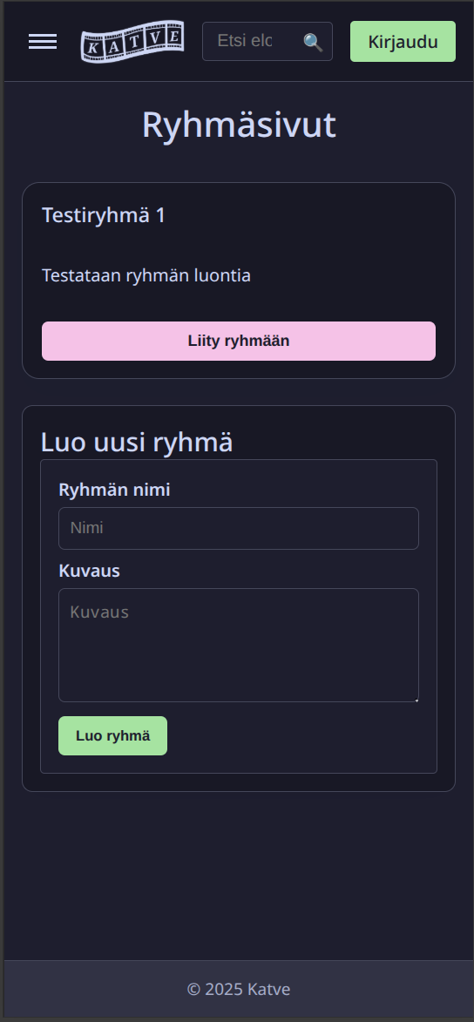
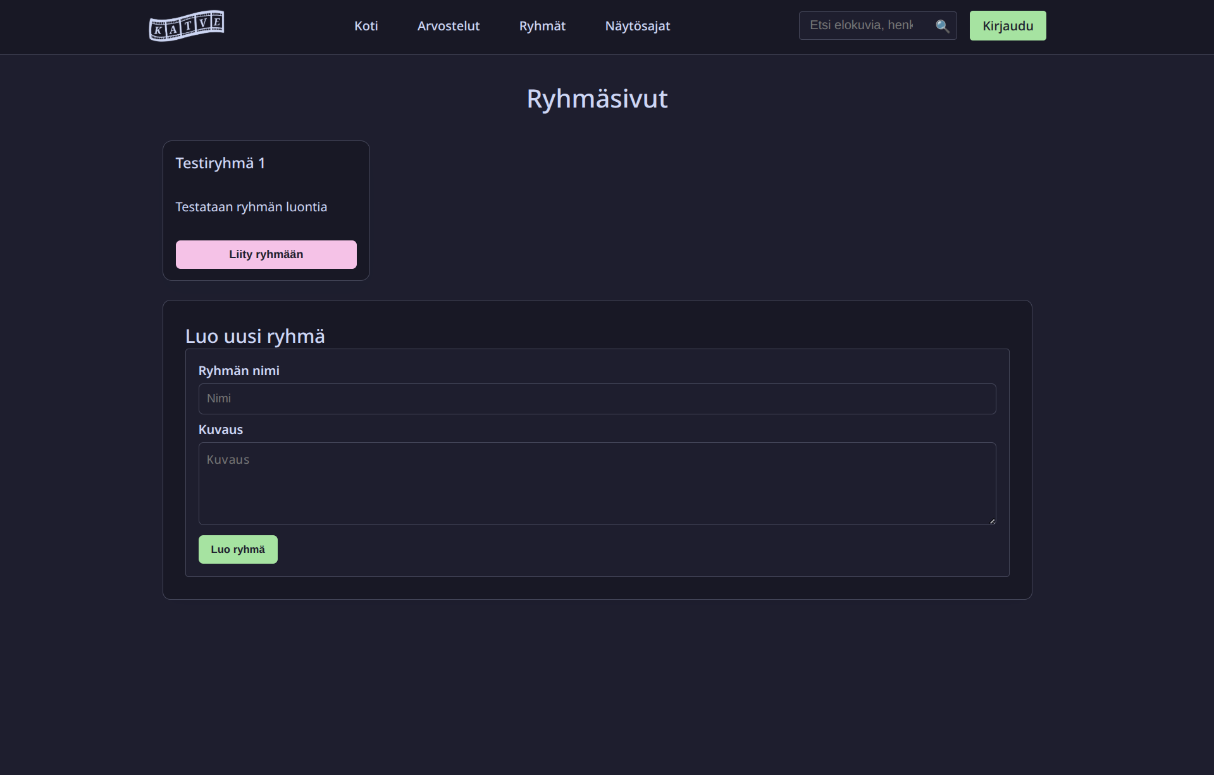
Responsiveness
The user interface scales sensibly for different resolutions so it's usable on mobile devices and desktop computers
Developers: Ville-Pekka and Kata
Time spent: 8 hours

Slide 5
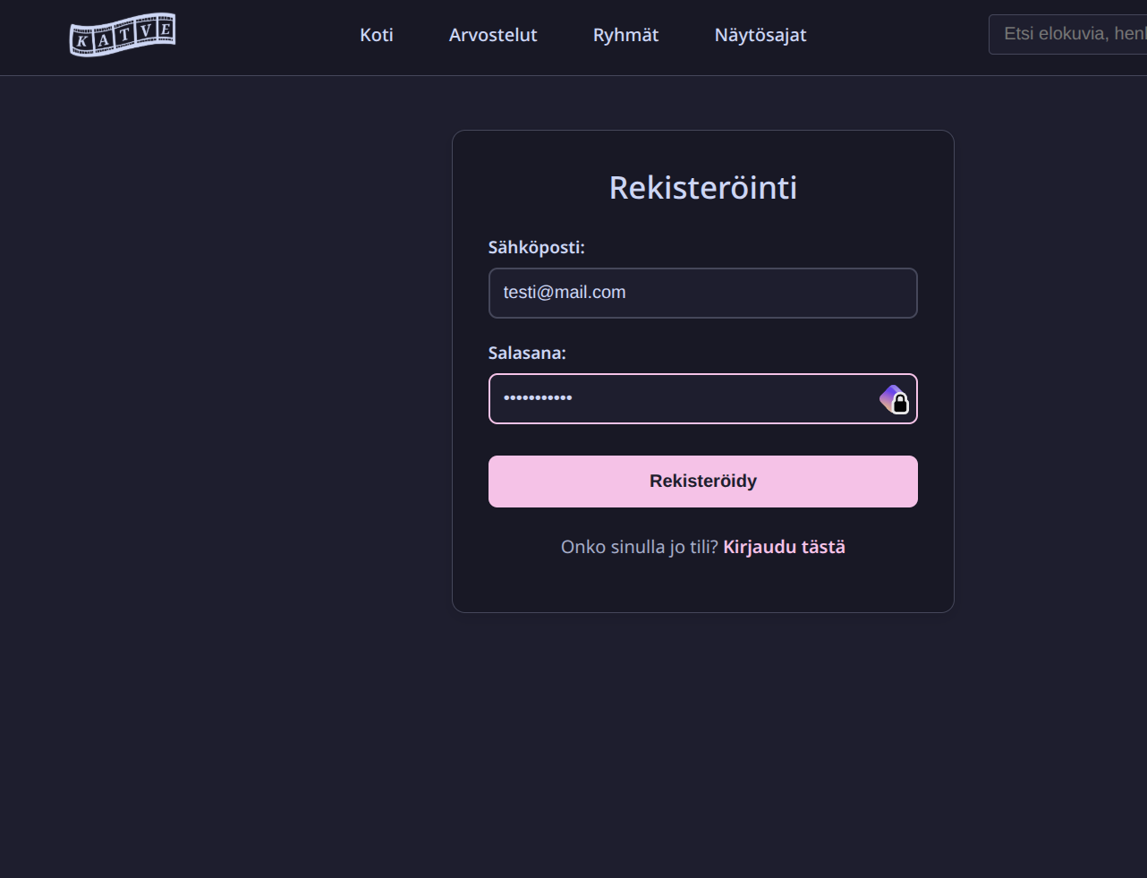
Register
The user can register to the app with email and password. The password needs to be at least 8 characters long and include at least one capital letter and number. The feature was implemented as required.
We worked on this feature as a team.
Time spent on this feature: 30h

Slide 6
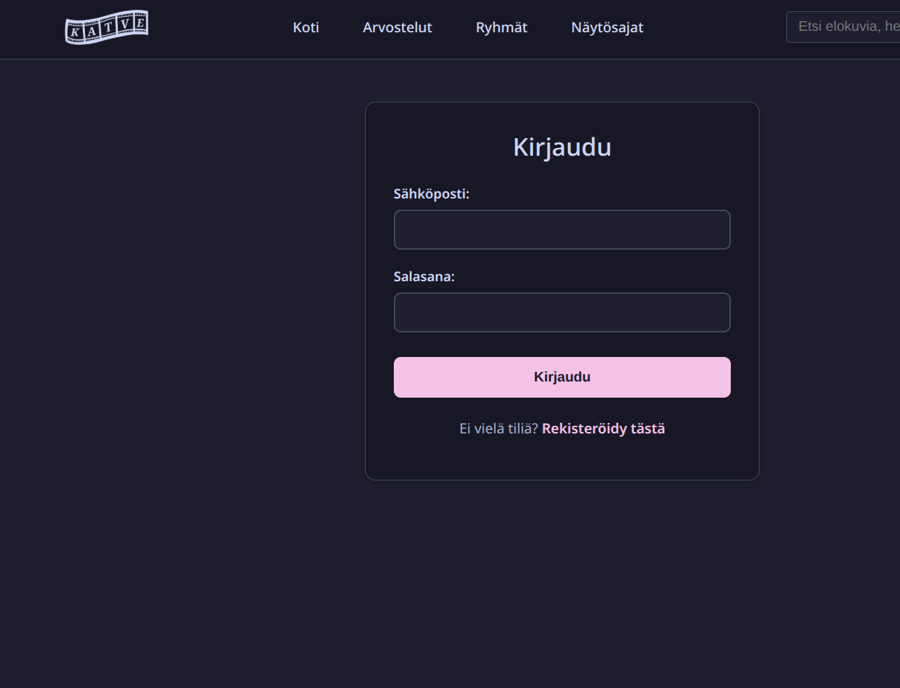
Log in
User can login with registered email and password. Authentication uses refresh token (cookie) with access token recycling.
Developers: We worked on this feature as a team.
Time spent on this feature: 30h

Slide 7
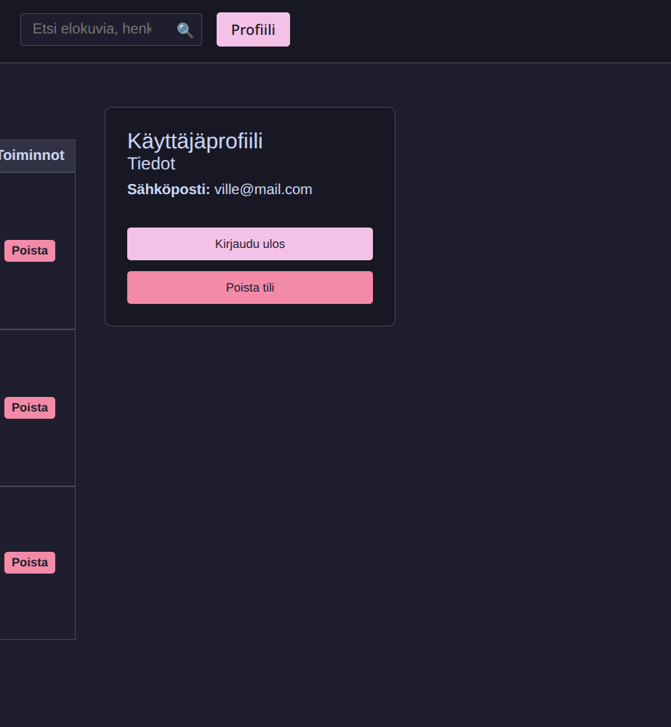
Account deletion:
An authenticated user can delete their user. When user deletes their account all the user data is removed from the database.
Developers: backend: Tuure, frontend Ville-Pekka, Kata.
Time spent: 15 hours

Slide 8
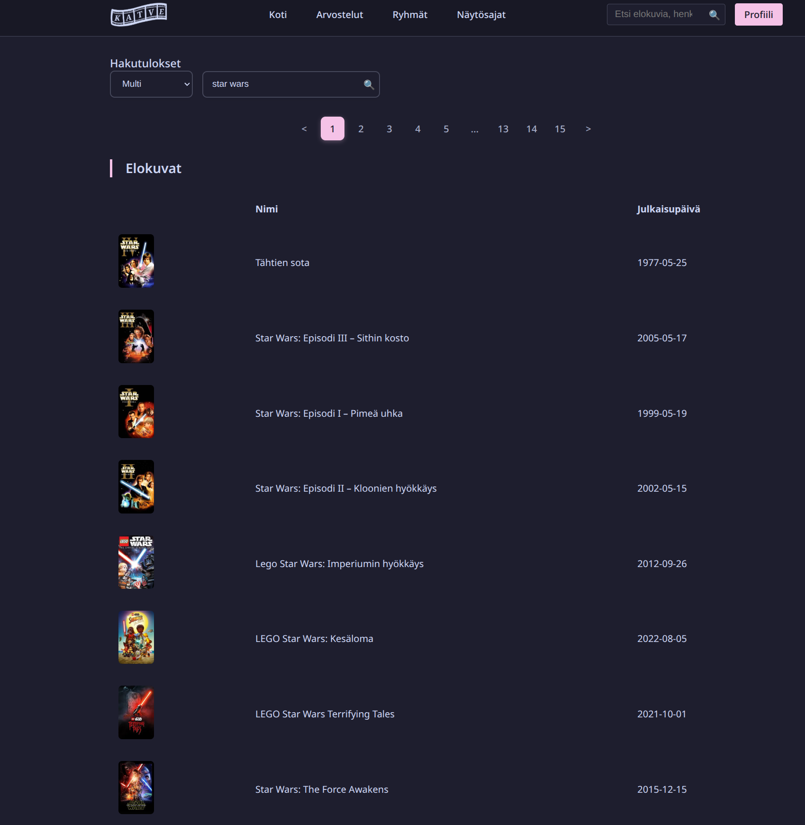
Search:
The user can search for movies with different attributes (name, date, actor/actress etc). User doesn't need to be logged in to search.
We implemented four different search criterias (multi-, movies-, tv- and persons search). Search uses themoviedb API
Developers: Ville-Pekka and Aapo.
Time spent: 19 hours.

Slide 9
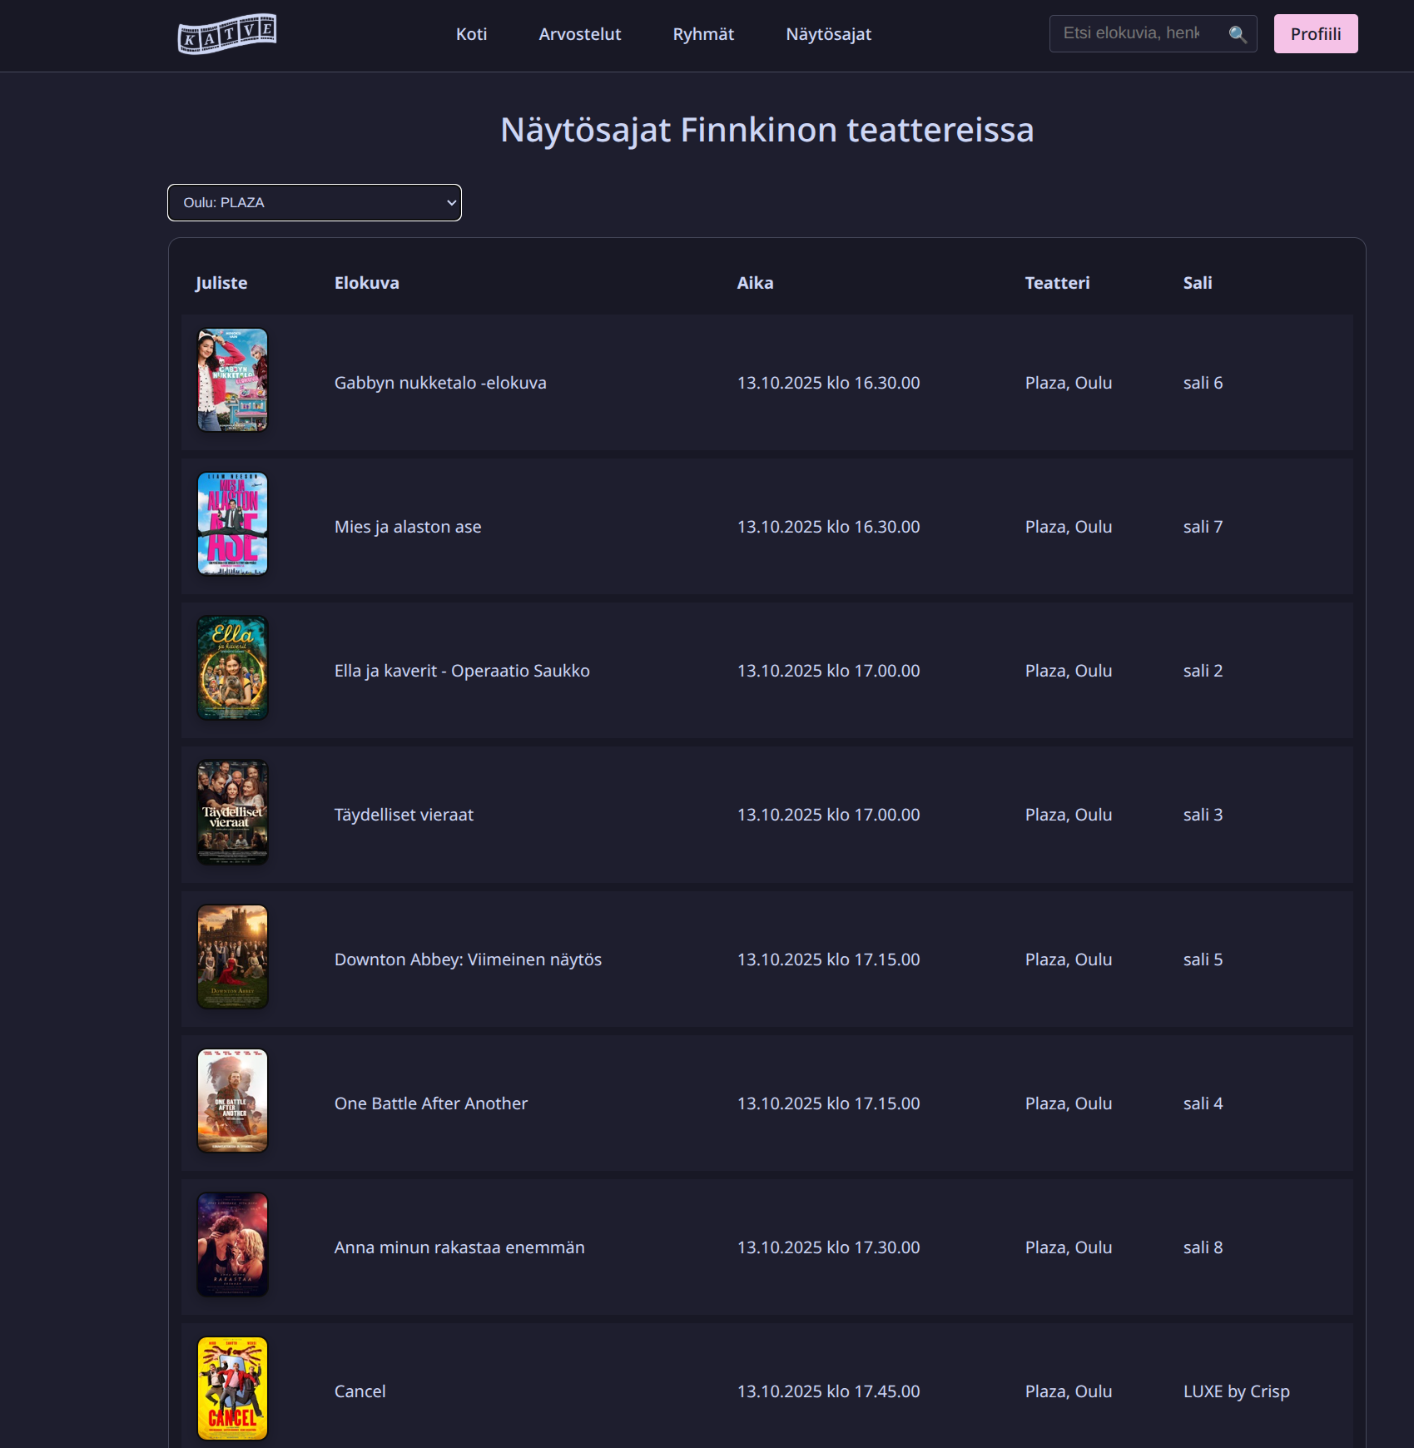
Showtimes:
User can browse movie showtimes from different Finnkino movie theaters. User doesn't need to be logged.
Developers: Kata, Emma and Aapo.
Time spent: 12 hours.

Slide 10
Aapo's presentation
Aapo had a work shift tonight so here's his part of the presentation.

Slide 11
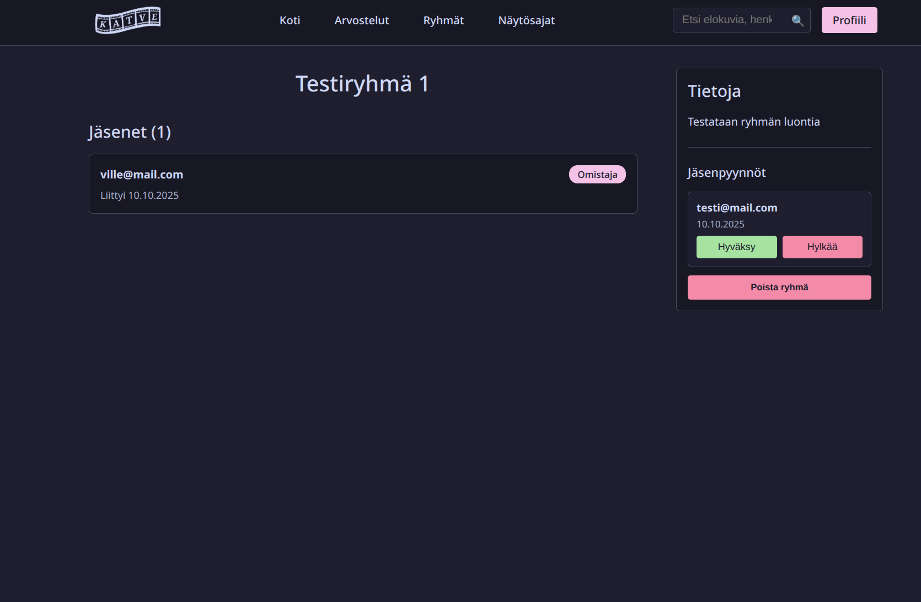
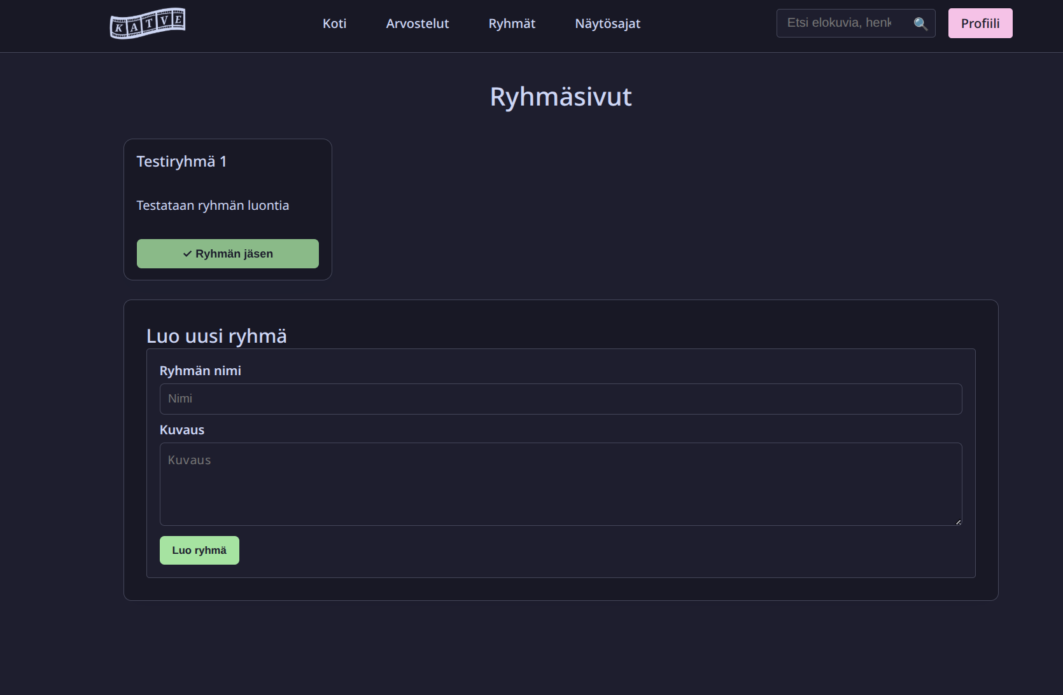
Group page:
Authenticated user can create or join a group. Group owner can accept/remove members from the group. Group can be deleted by the owner. Everyone can browse active groups.
Developers: Ville-Pekka, Kata and Emma.
Time spent: 33 hours.

Slide 12
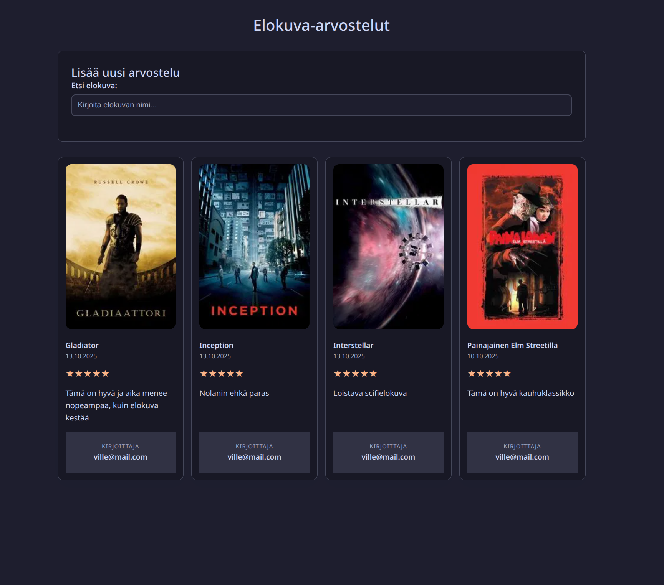
Reviews:
Users can add a movie review. They need to be logged in to add a review. The review consists of text and one to five stars. The review shows the user's email and the time the review was made.
Developers: Ville-Pekka and Emma.
Time spent: 24 hours

Slide 13
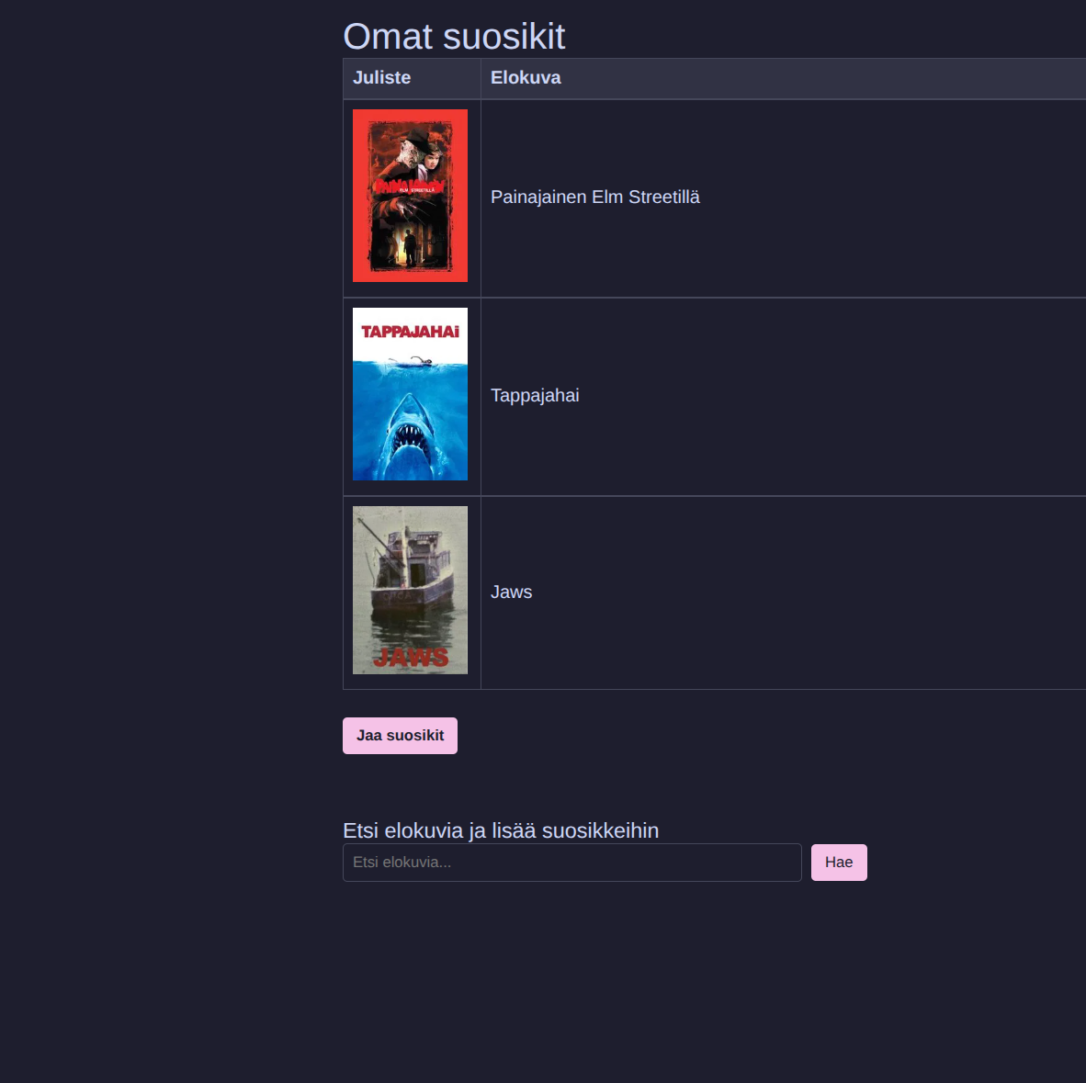
Create favorites list
The user needs to be logged in to create a favorites page. The favorites page needs to be displayed on their profile list.
Developers: Aapo and Kata.
Time spent: 18 hours.

Slide 14
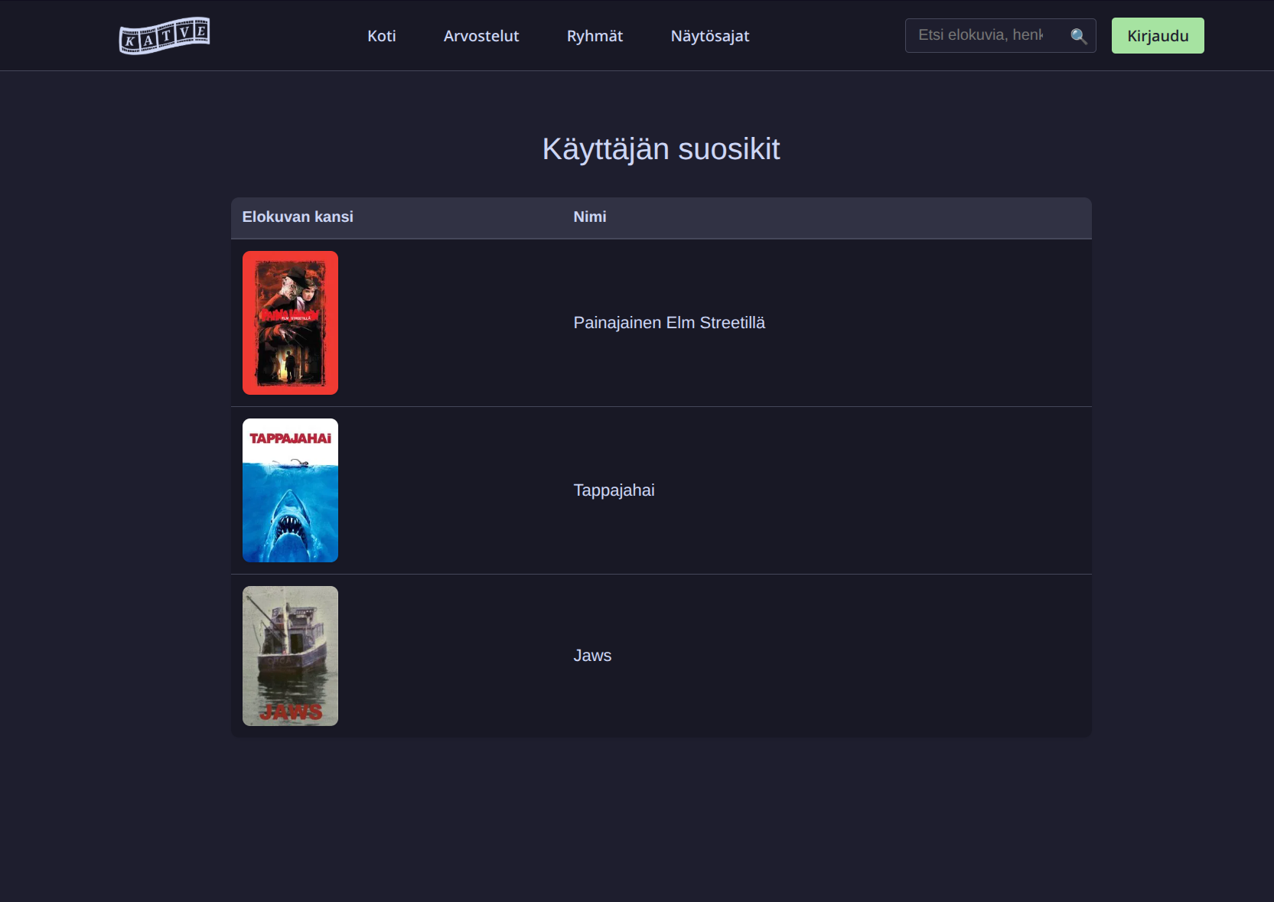
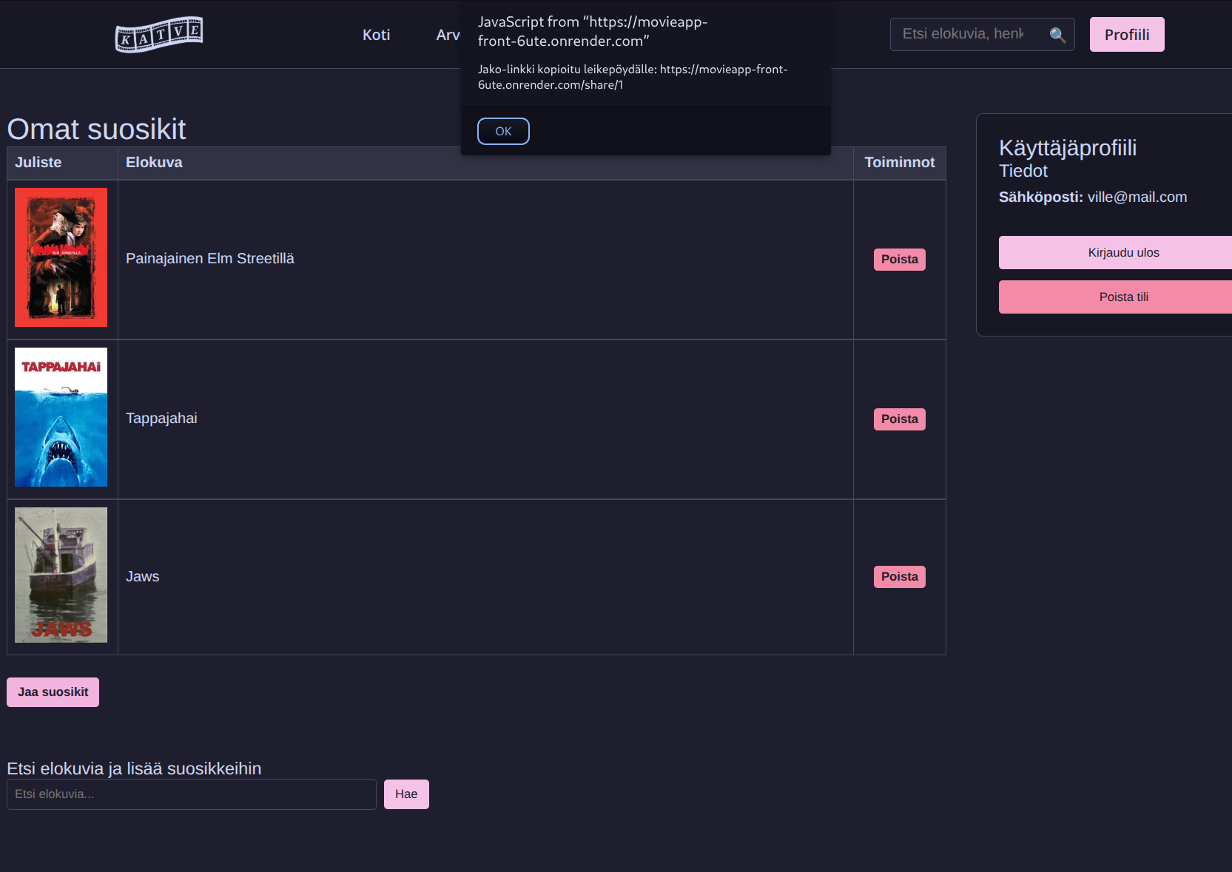
Sharing a favorite list
A logged in user can share their own favorites list as a URI to a website that will be displayed to all users.
Developers: Aapo and Tuure.
Time Spent: 3 hours.

Slide 15
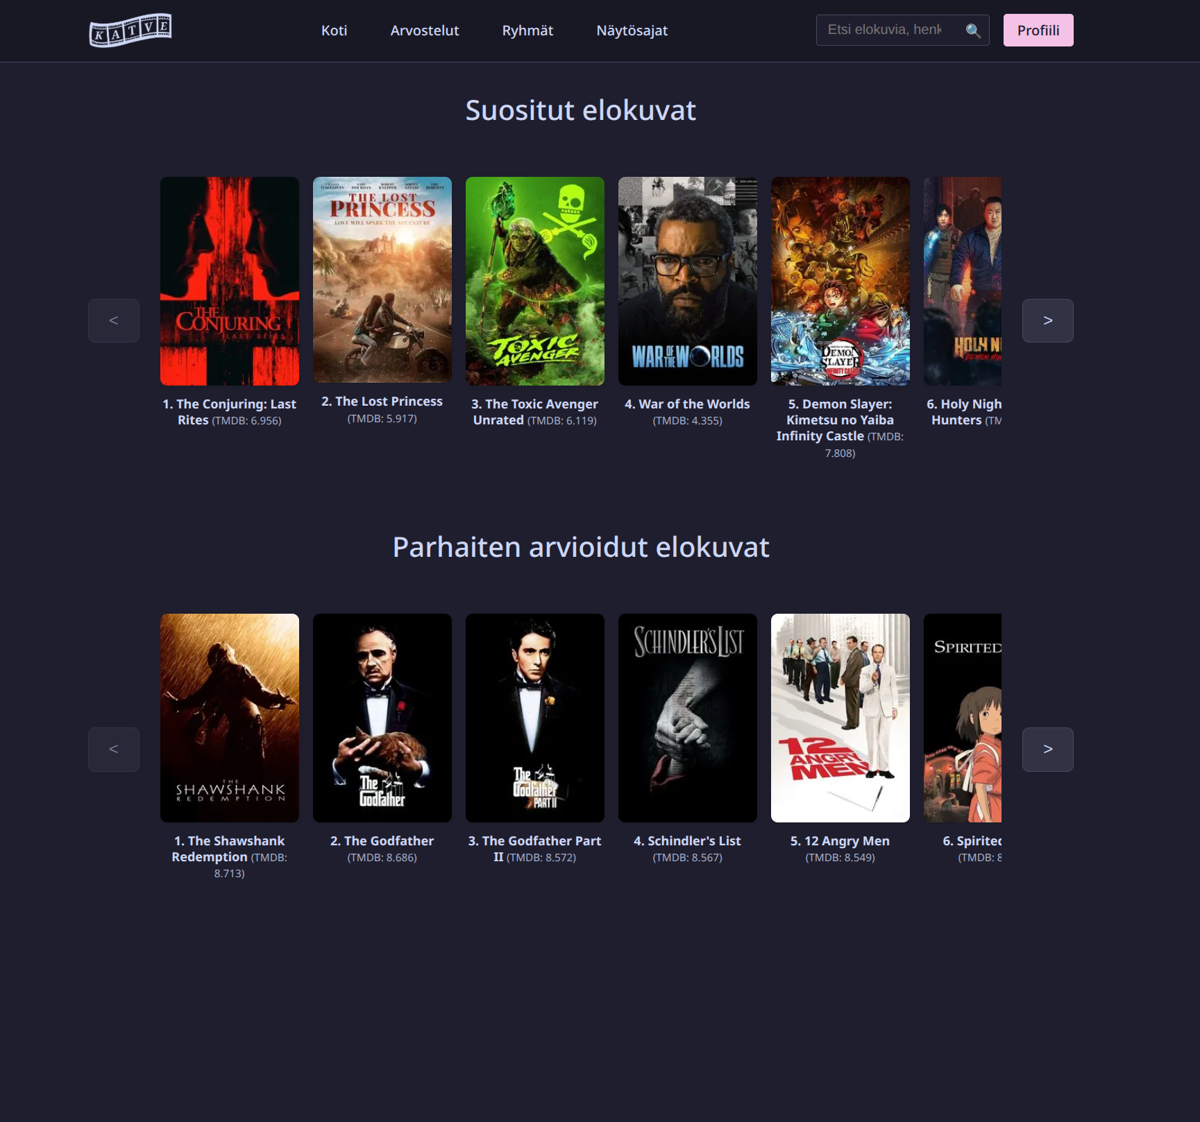
Optional feature: Homepage's movie carousel:
Description: Frontpage carousels to show trending movies and top rated movies from the movie database
Developer: Ville-Pekka.
Hours: 4 hours.

Slide 16
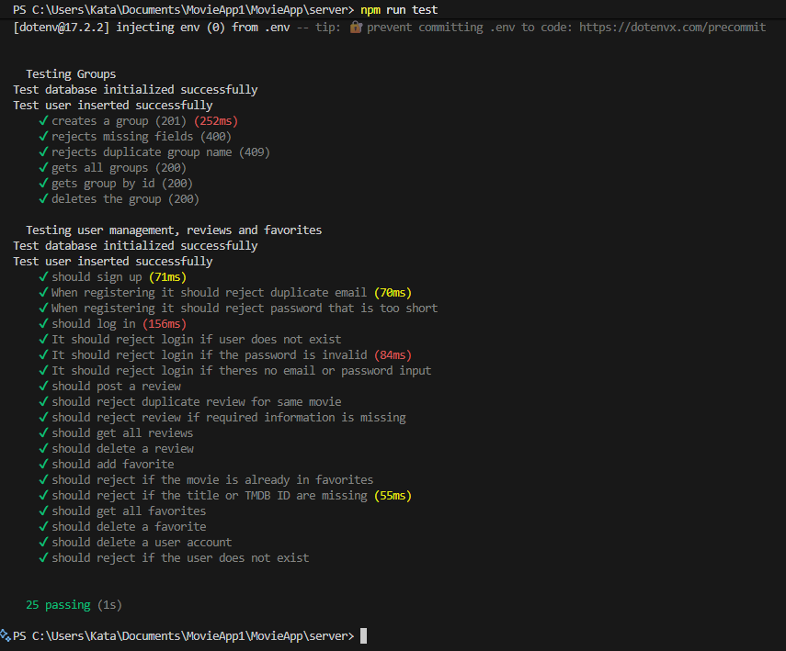
Tests:
Here is a list of all the tests we coded for the project.
Developers: Ville-Pekka, Kata, Aapo ja Emma.
Hours: 5 hours.

Slide 17
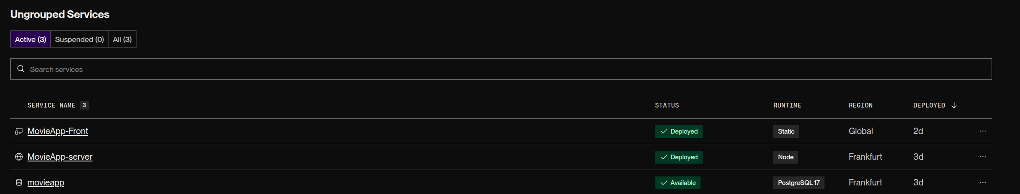
Published on Render:
Site is online and reachable in:
https://movieapp-front-6ute.onrender.com
Developers: Ville-Pekka and Kata
Hours: 8 hours

Slide 18
RefreshToken needs 3rd party cookies in browser if backend and frontend are in different domains
How to use react in our project.
What we learned?
Communication
Project management
Better problem solving skills, patience and time management

Slide 19
Group membership status system was challenging to implement
We worked really well as a team & communicated well
What was successful/challenging?
Setting up the different tables in the database was a bit difficult
we stayed on schedule well
Weekly goals

